Slide 1

Machine Learning Decision Tree
By K. Igwe 2021

Slide 2
Lesson Objectives
Define Decision Tree
Structure of a Decision Tree
Application
ID3 Algorithm(Training Data)

Slide 3
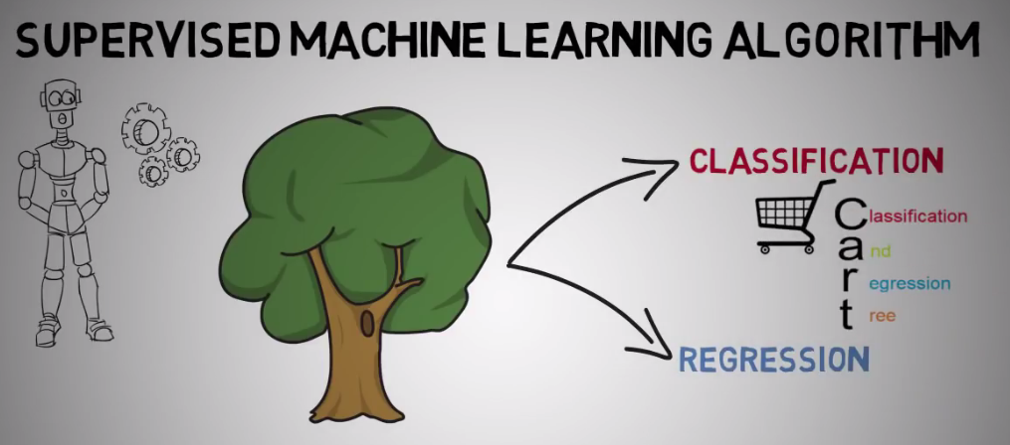
Decision Tree/Divide and Conquer Rules
apply a strategy of dividing data into smaller and smaller portions, while at the same time an associated decision tree is incrementally developed to identify patterns that can be used for prediction.
ﬂowchart
Supervised Learning Algorithm
Classification Algorithm-used
in classification and Regression
Problems(CART)
Classification And Regression Tree
(CART)

Slide 4
Application
Decision Making Purposes
Credit scoring models in which the criteria that causes an applicant to be rejected need to be well-specified
Marketing studies of customer churn or customer satisfaction that will be shared with management or advertising agencies
Diagnosis of medical conditions based on laboratory measurements, symptoms, or rate of disease progression

Slide 5
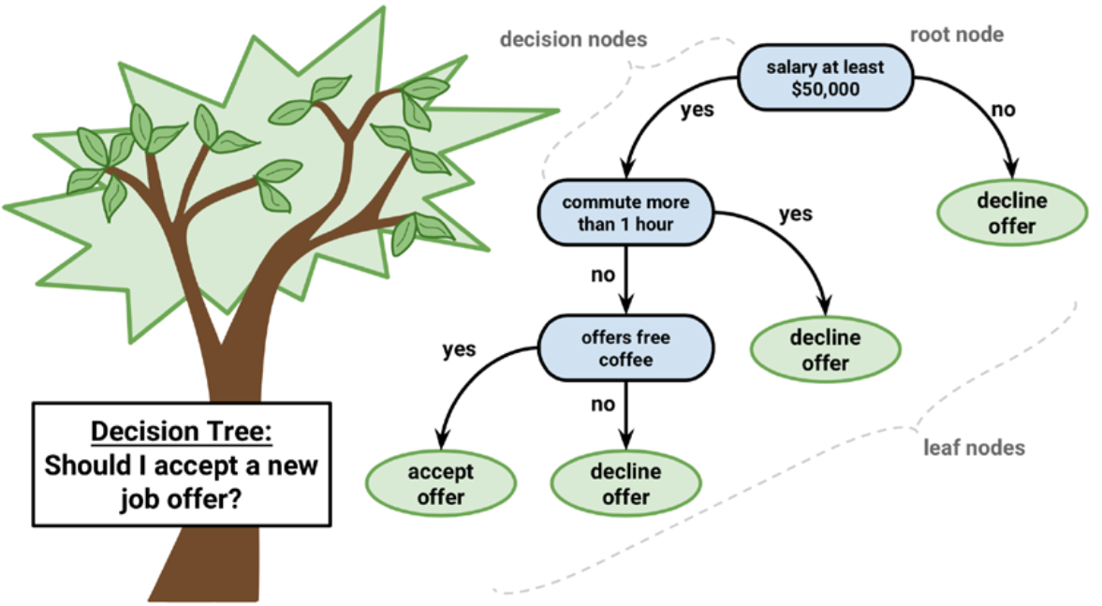
Decision tree structure
tree structure that models the relationships among the features and the potential outcomes
branching decisions, which channel examples into a final predicted class value
E.g.,
Decision nodes – split the data across branches
Root node-best predictor
Edges/Branches- decision's choices
Leaf nodes (terminal nodes – the action to be taken or expected results)

Slide 6
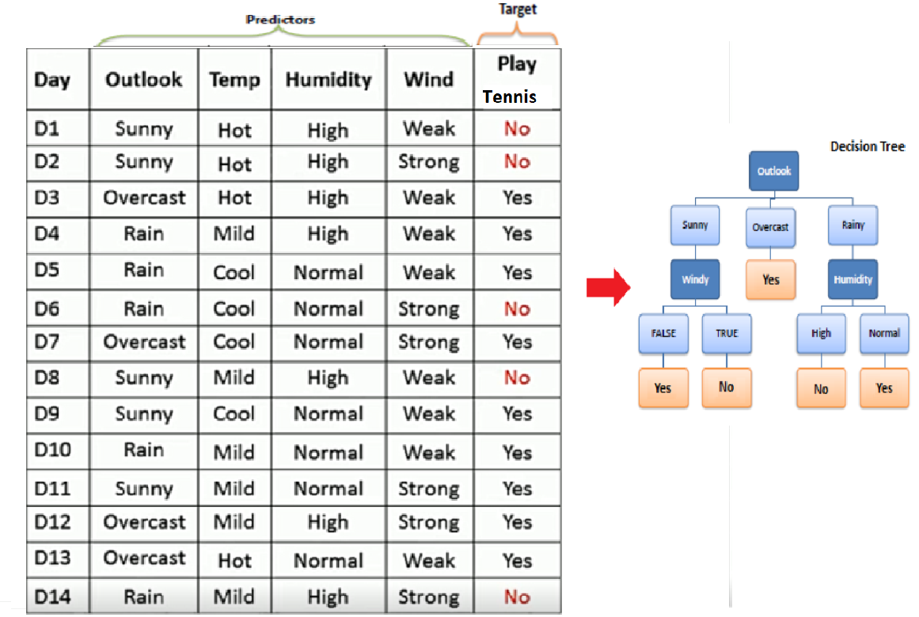
Type of Data
Decision trees can handle both categorical and numerical data.

Slide 7
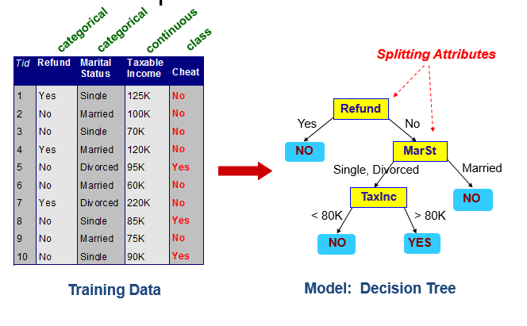
Type of Data
Decision trees can handle both categorical and numerical data.

Slide 8
ID3 algorithm
The core algorithm for building decision trees called ID3((Iterative Dichotomiser 3))
by J. R. Quinlan
Employs a top-down, greedy search through the space of possible branches(Divide and Conquer)
ID3 uses Entropy and Information Gain to construct a decision tree.

Slide 9
Entropy
Def:- Entropy is the Uncertanity of information that is contained in an Attribute.
A decision tree is built top-down from a root node and involves partitioning the data into subsets that contain instances(tables) with similar values (homogenous).
ID3 algorithm uses entropy to calculate the homogeneity of a sample.
If the sample is completely homogeneous the entropy is zero and;
If the sample is equally divided it has entropy of one.

Slide 10
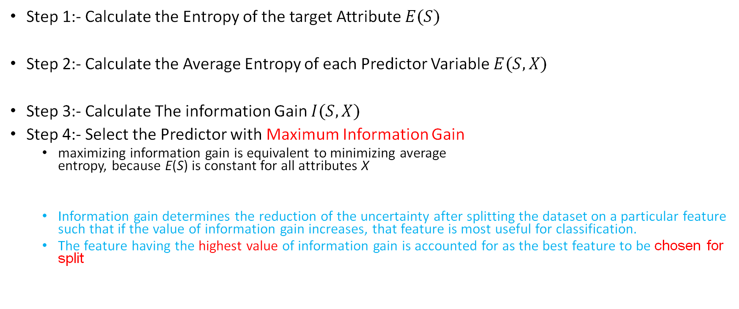
Steps.
Step 1:- Calculate the Entropy of the target Attribute $E(S)$
Step 2:- Calculate the Average Entropy of each Predictor Variable $E(S, X)$
Step 3:- Calculate The information Gain $I(S,X)$
Step 4:- Select the Predictor with Maximum Information Gain
maximizing information gain is equivalent to minimizing average entropy, because E(S) is constant for all attributes X
Information gain determines the reduction of the uncertainty after splitting the dataset on a particular feature such that if the value of information gain increases, that feature is most useful for classification.
The feature having the highest value of information gain is accounted for as the best feature to be chosen for split

Slide 11
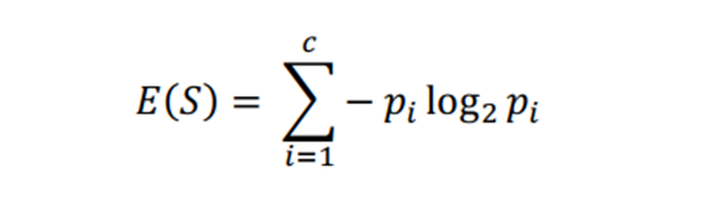
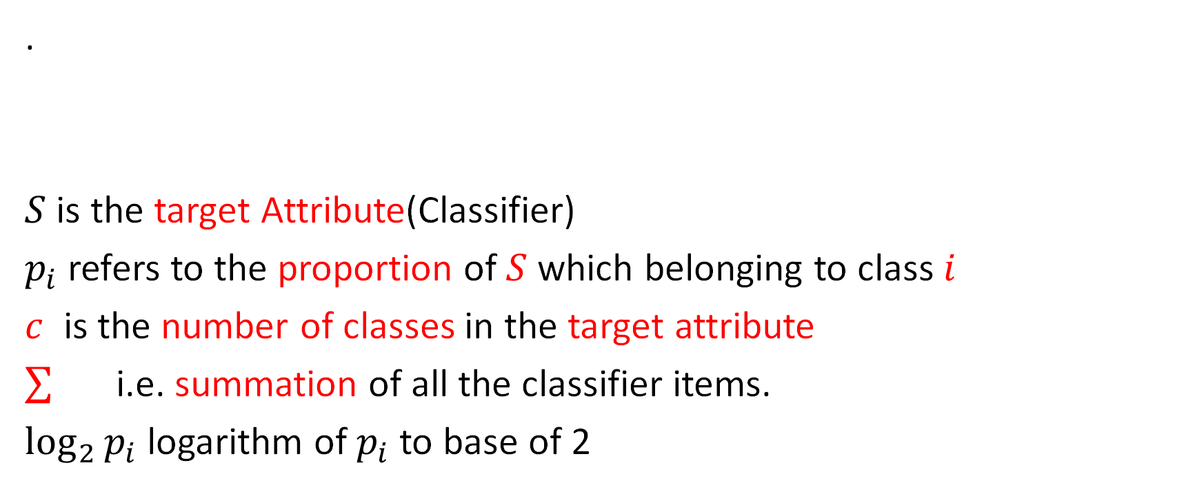
Entropy formula
.
$S$ is the target Attribute(Classifier)
$p_{i}$ refers to the proportion of $S$ which belonging to class $i$
$c$ is the number of classes in the target attribute
i.e. summation of all the classifier items.
$\log_{2}{p_{i}}$ logarithm of $p_{i}$ to base of 2

Slide 12
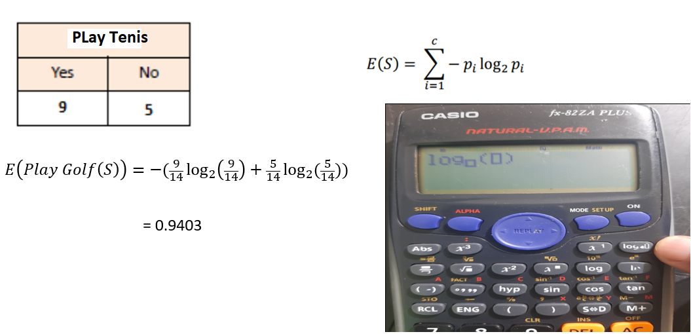
Step1 : Entropy of a Target

Slide 13
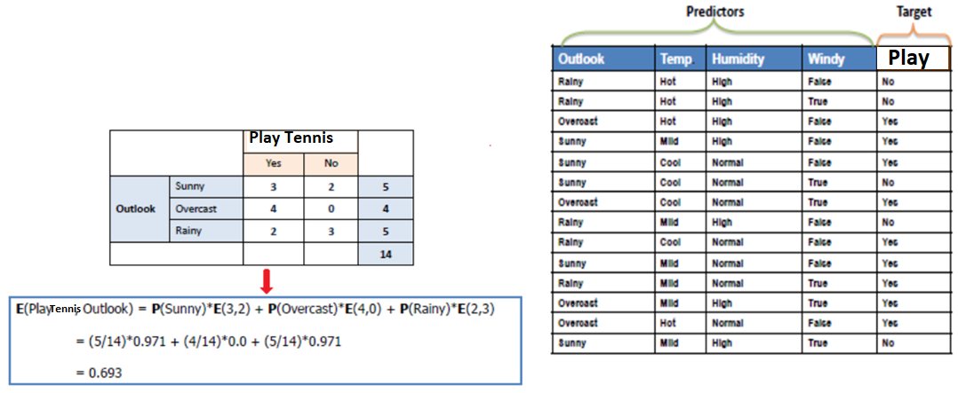
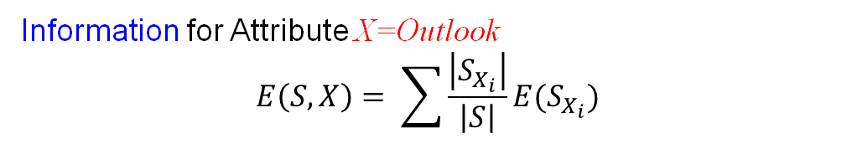
Average Entropy/Information
Information for Attribute X=Outlook
$$E\left(S,X\right)= \sum{\frac{\left|S_{X_{i}}\right|}{\left|S\right|}E(S_{X_{i}})}$$

Slide 14
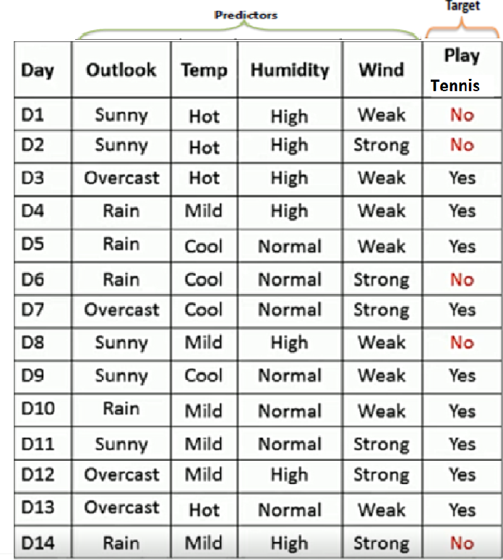
Example Data set
Use a decision tree to Classify the weather conditions favourable for an individual to/not to Play Tennis.
NB: We are going to break this Table into some small homogeneous instances, as we develop our DT
1 which attribute is giving the maximum information?
We want to calculate the Information gain for each attribute and compare.
The attribute with the highest information gain must be the route node.

Slide 15
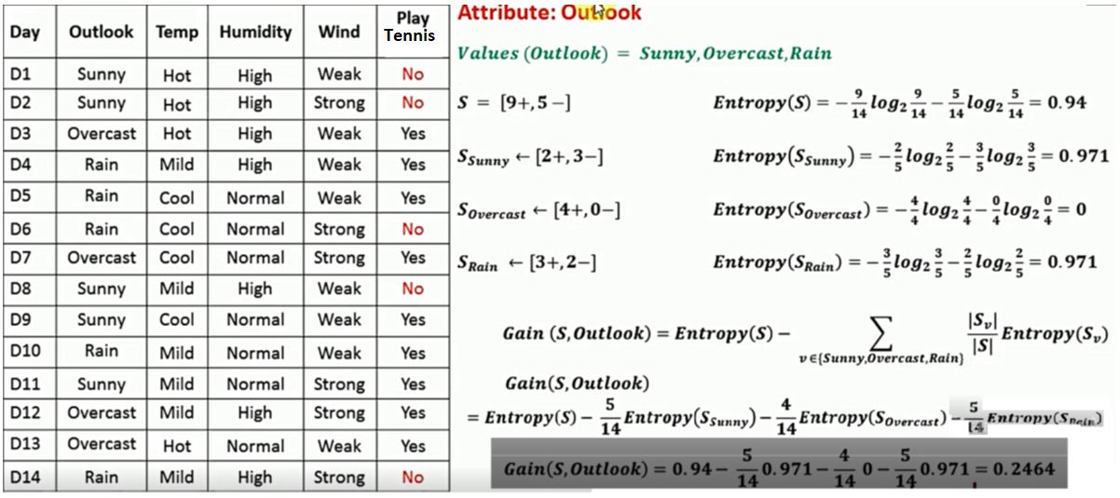
Windy, Temp and Humidity [outlook]
In order to calculate the information gain of every attribute we need to calculate the Entropy (S) of the Entire dataset first.
calculate the Entropy of each possible attribute value.
Note: If either of the two is 0 the entropy is always 0 and 1 if there are equal + and -.
Subtract sum of the Ratio of each value *Entropy of its respective value from Entropy (S) of the whole dataset to get the Information gain for the attribute

Slide 16
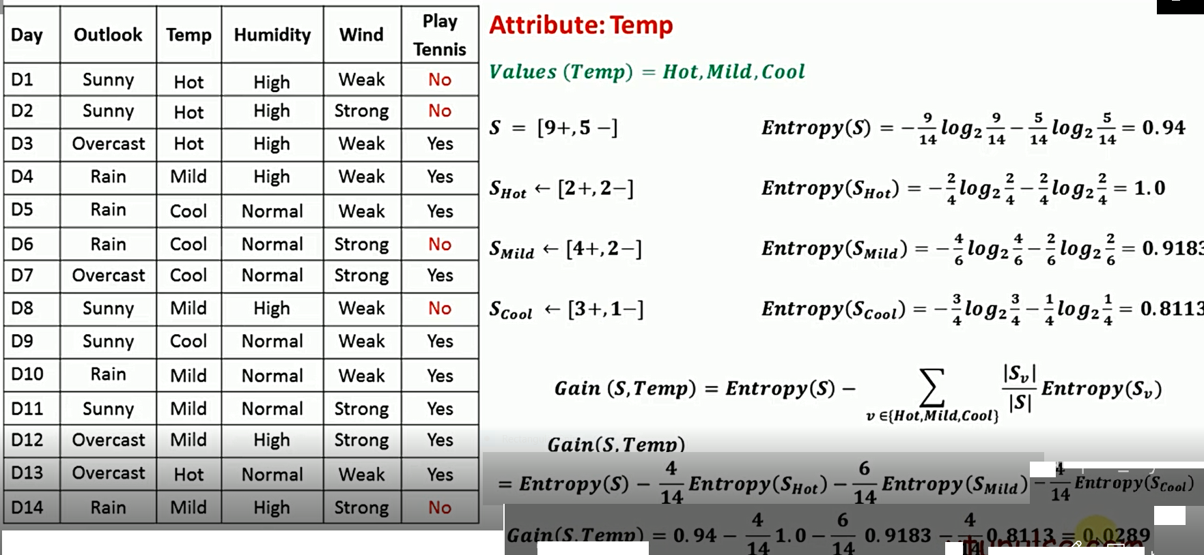
Temperature
calculate the Entropy (S) of the Entire dataset first.
calculate the Entropy of each possible attribute value.
Note: If either of the two is 0 the entropy is always 0 and 1 if there are equal + and -.
Gain of Temp with respect to S

Slide 17
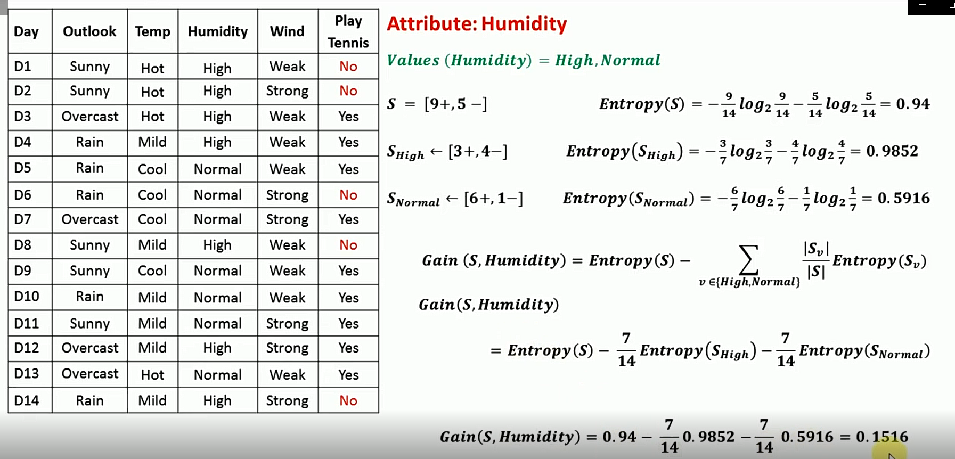
calculate the Entropy (S) of the Entire dataset first.
calculate the Entropy of each possible attribute value.

Slide 18
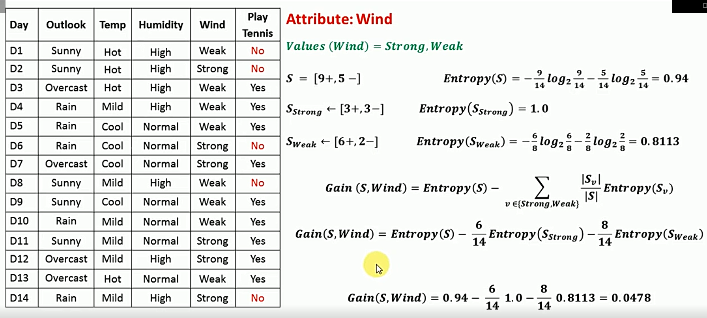
Wind
calculate the Entropy (S) of the Entire dataset first.
calculate the Entropy of each possible attribute value.

Slide 19
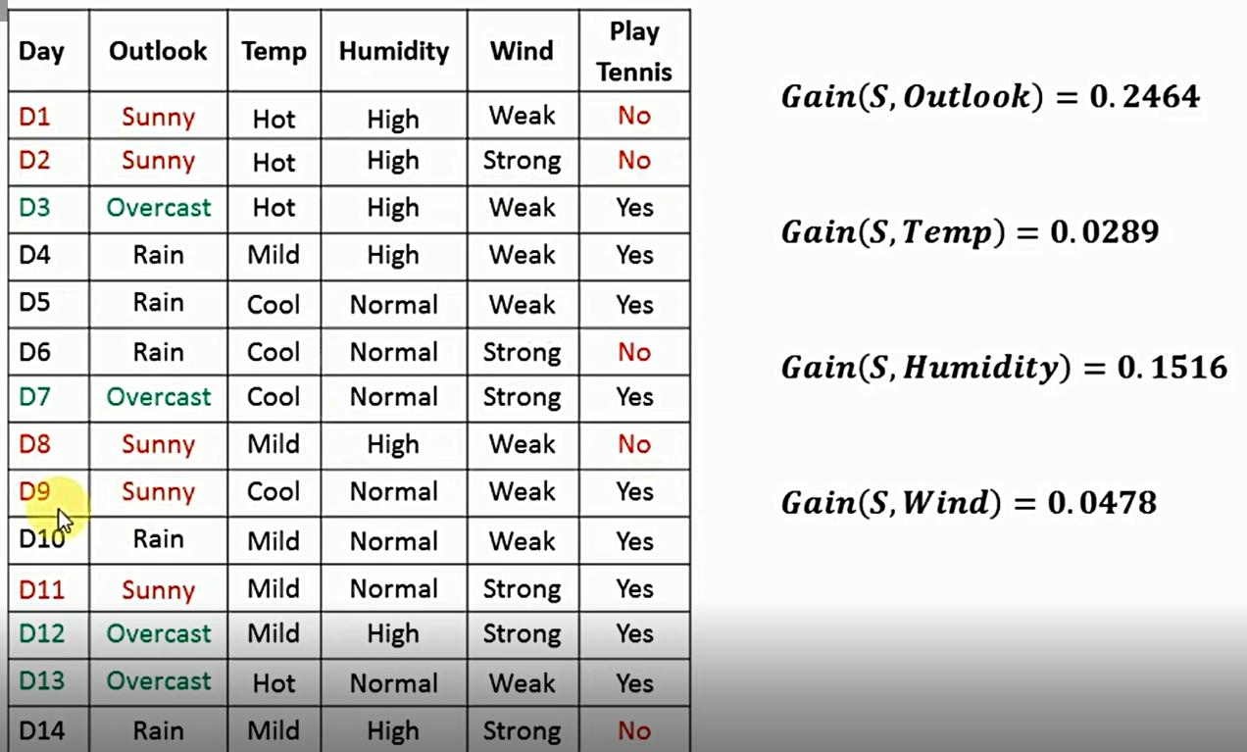
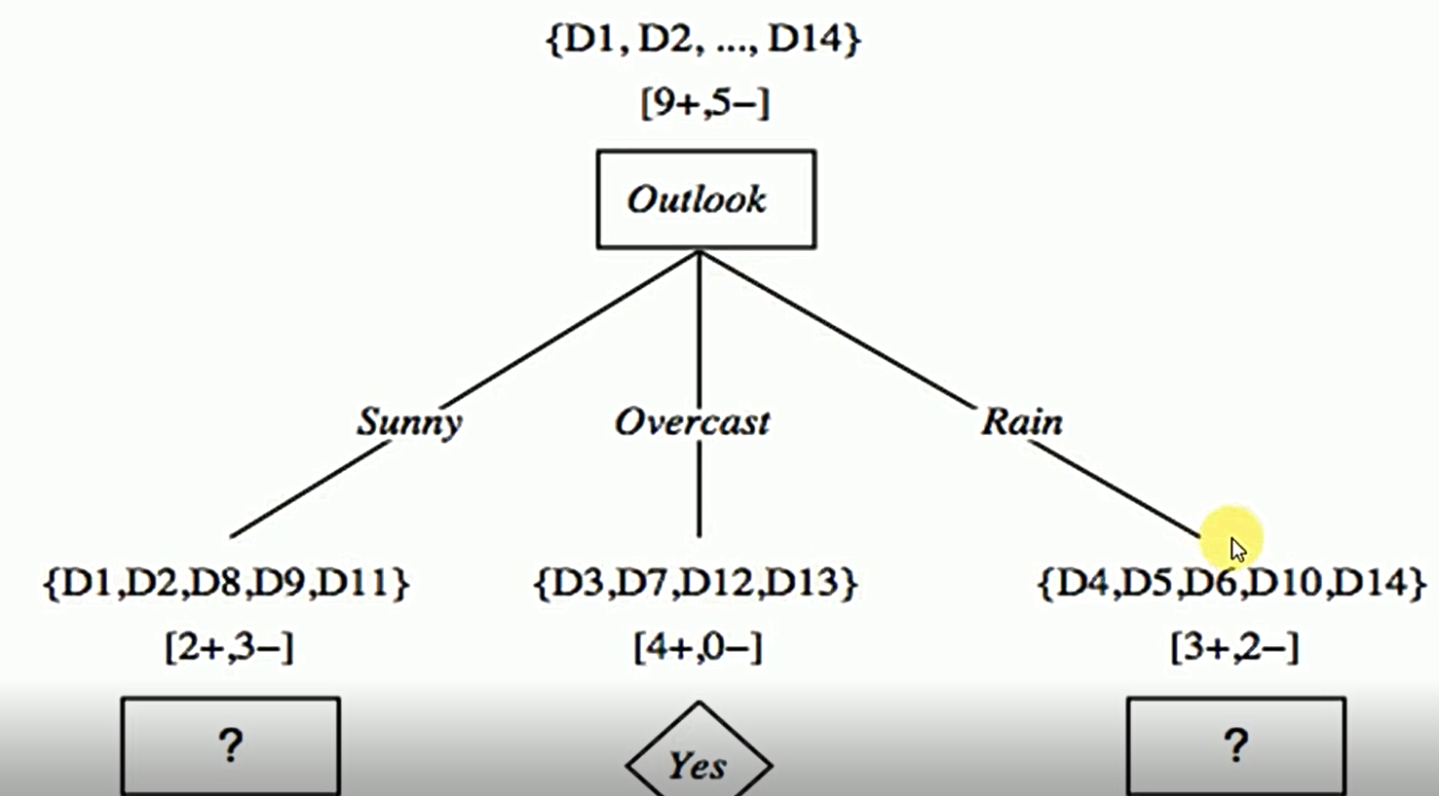
Attribute with Maximum Information Gain
Consider as the root node

Slide 20
Consider Each branch
Calculate attribute with highest information gain
Calculate attribute with highest information gain

Slide 22
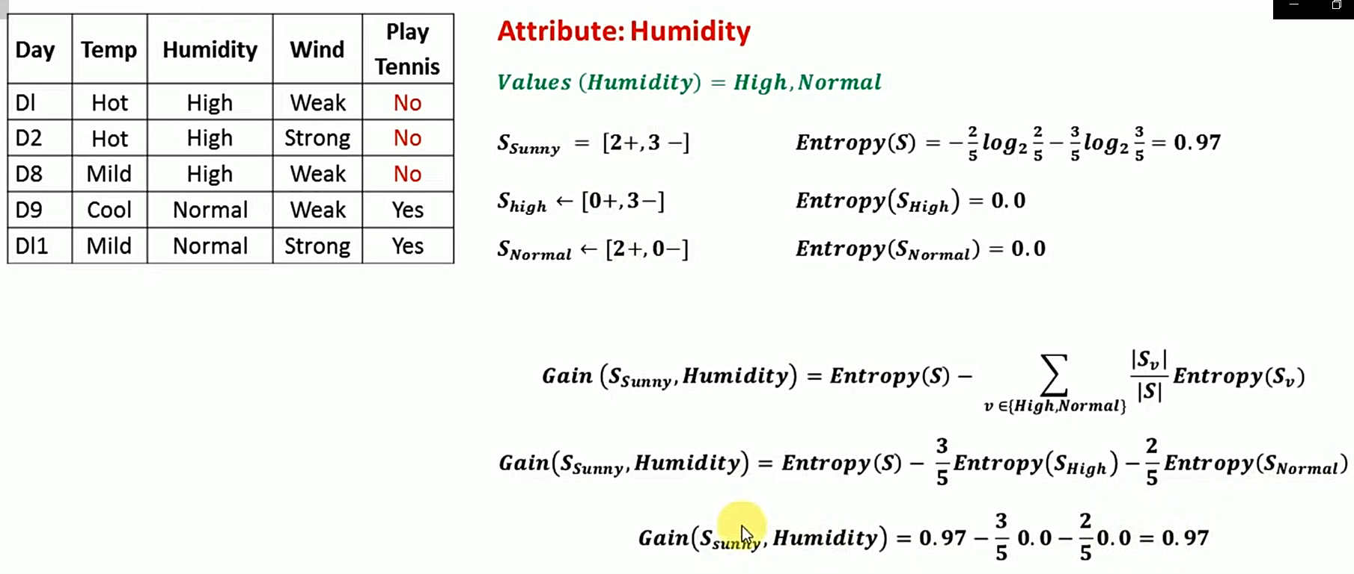

Slide 23
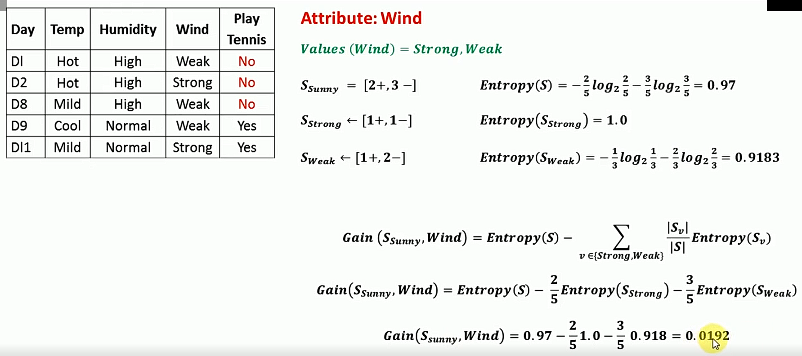

Slide 24
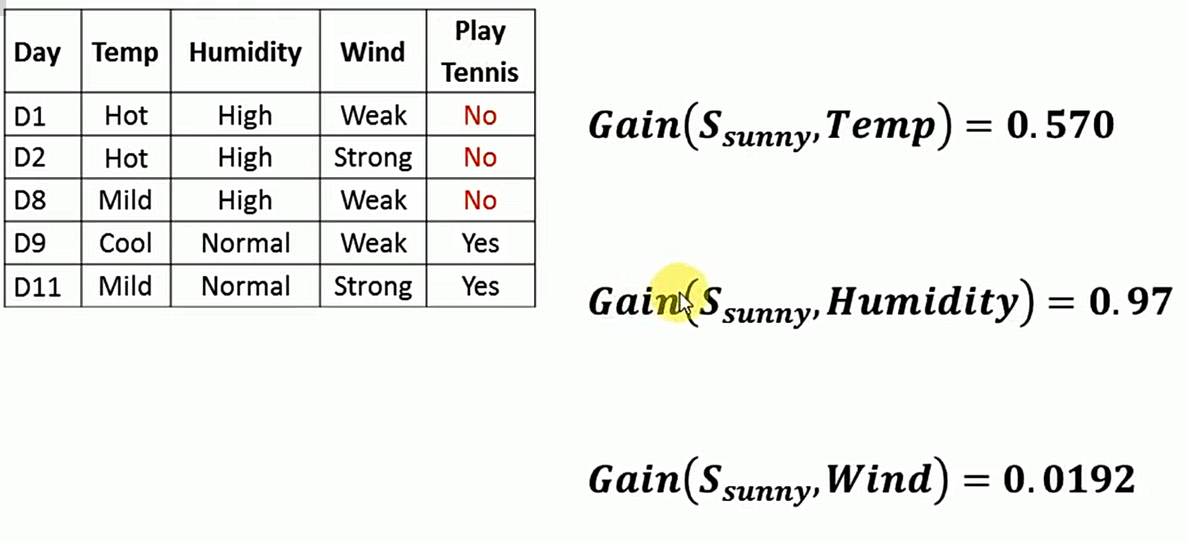
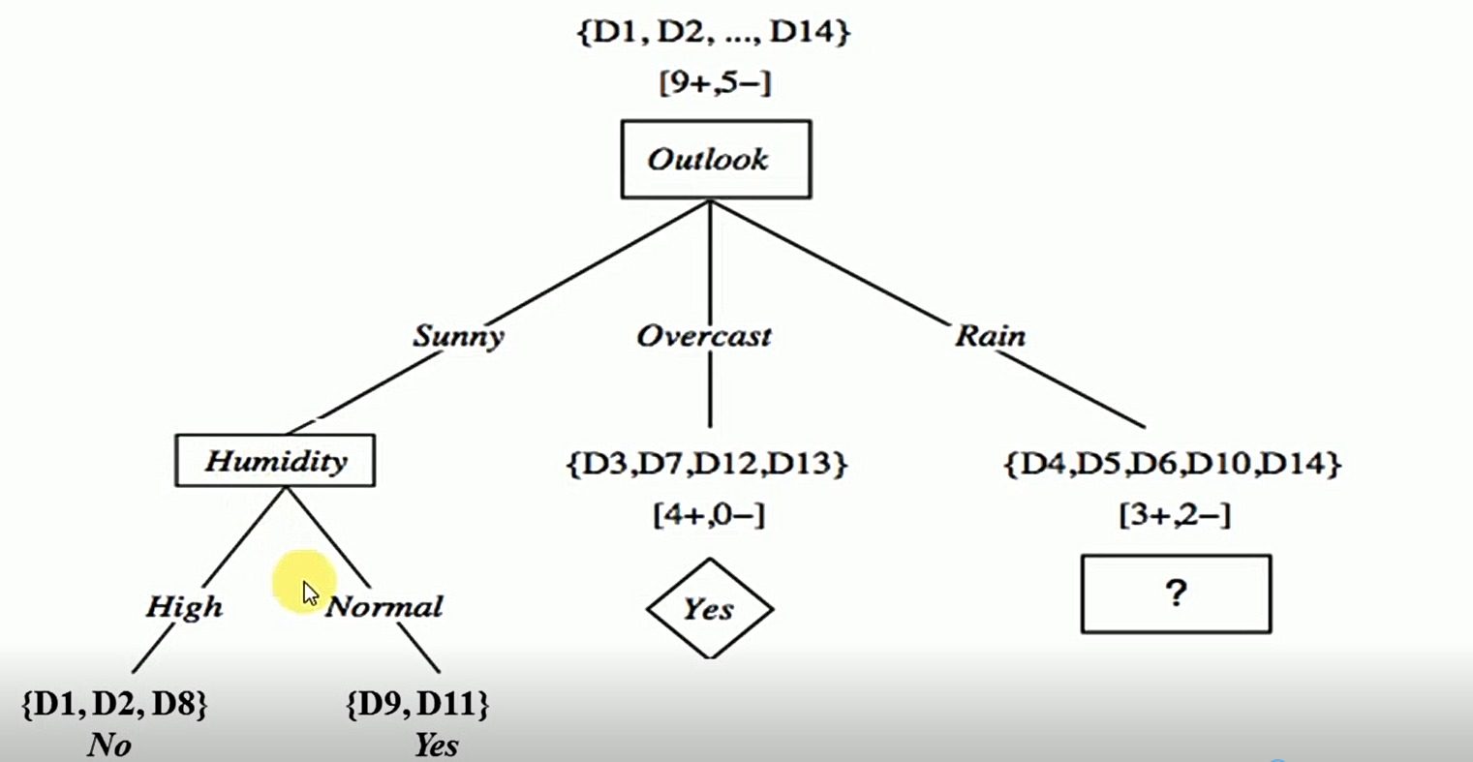
Attribute with Maximum Information Gain

Slide 26
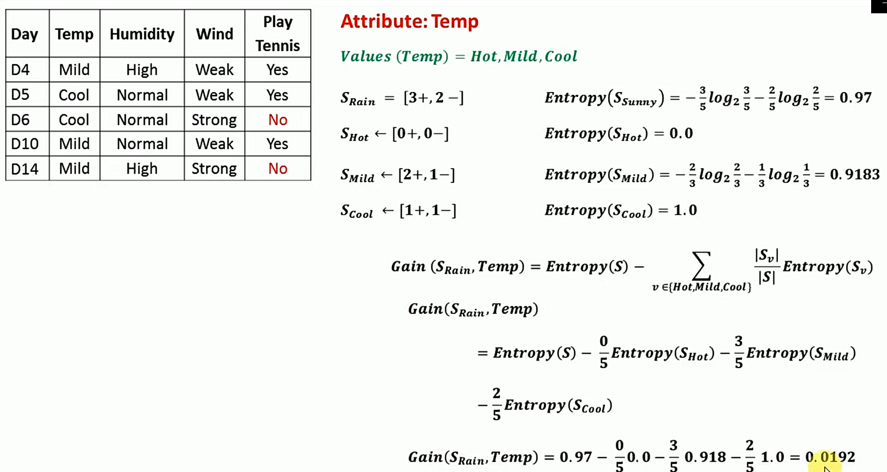
Note: If either of the two is 0 the entropy is always 0 and 1 if there are equal + and – exception 0

Slide 27
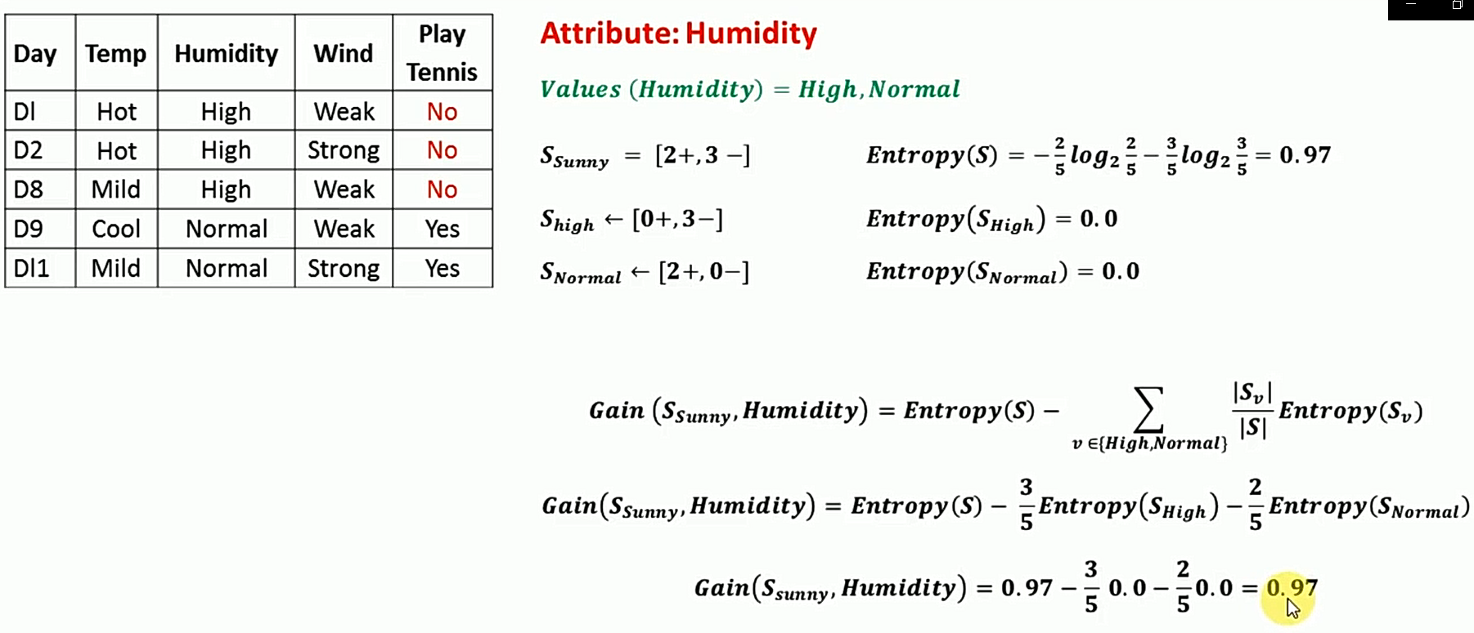

Slide 28
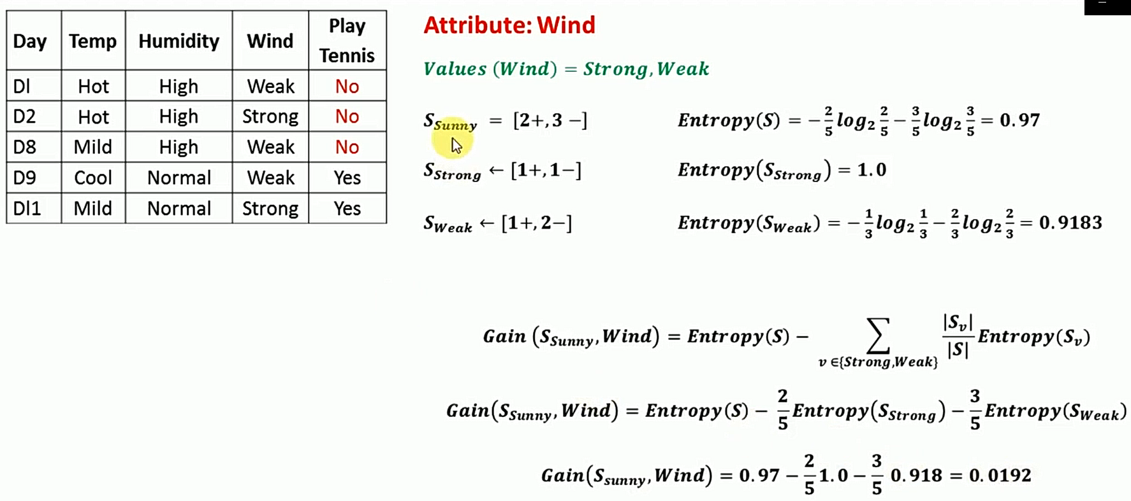

Slide 29
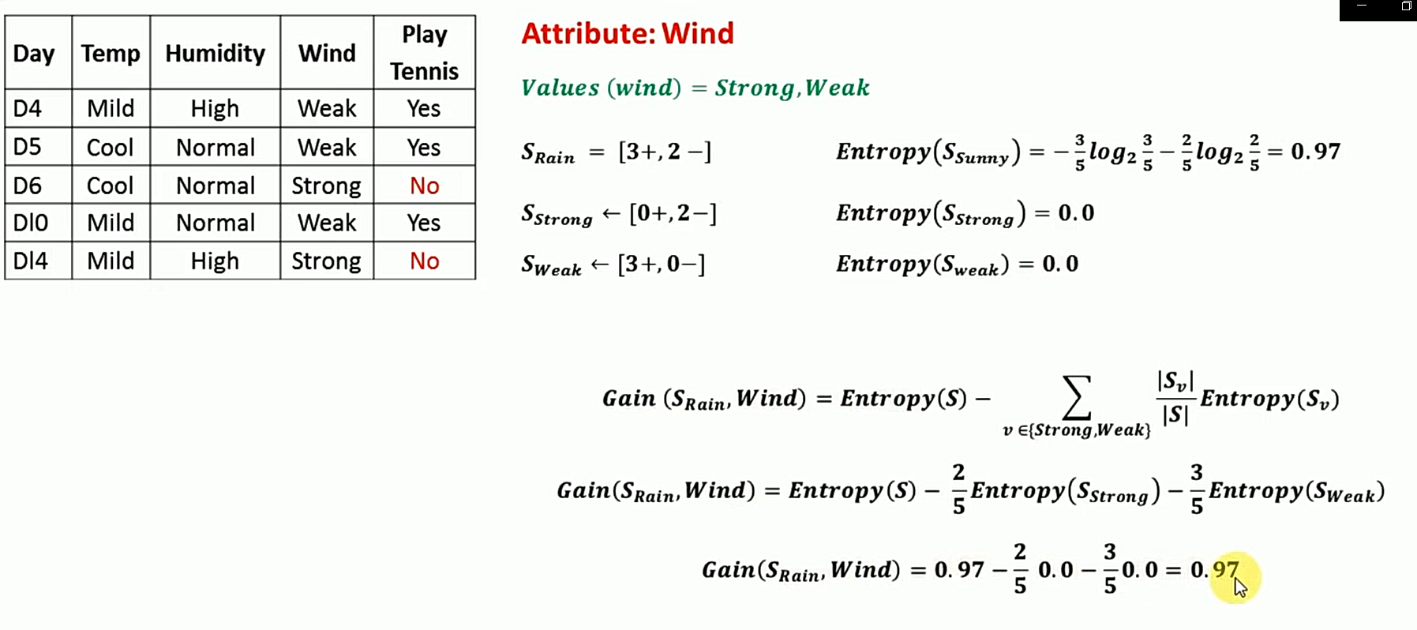

Slide 30
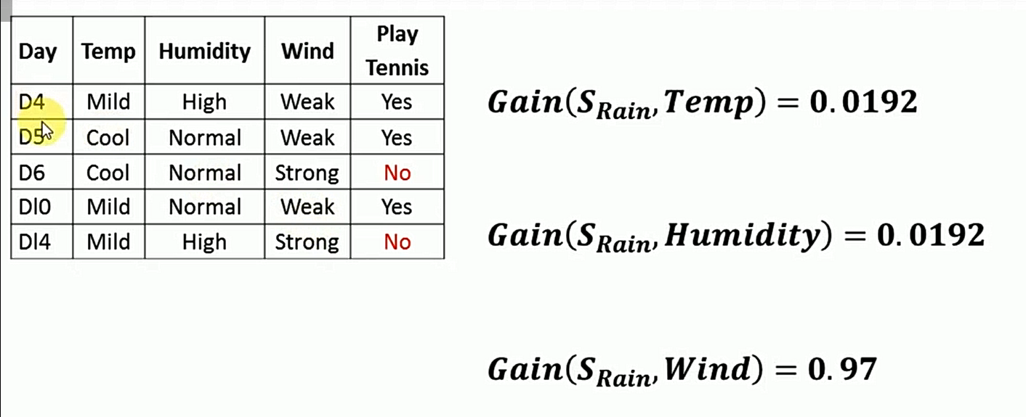
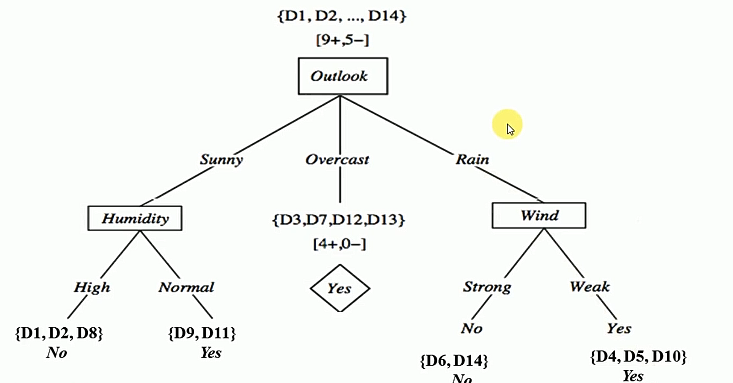
Attribute with Maximum Information Gain with respect to outlook

Slide 31
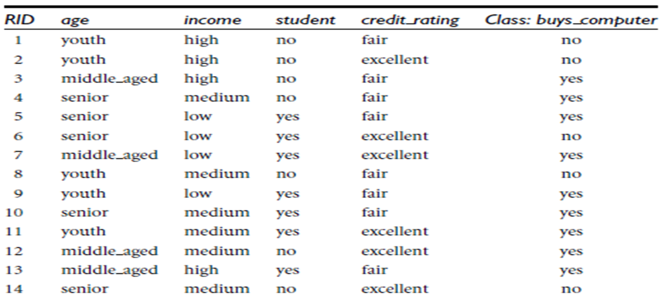
Exercise
Table presents a training set,D, of class-labeled tuples from the database.
Each attribute is discrete-valued
Class label attribute, buys computer, has two distinct values (namely, {yes, no})
.
compute the information gain of each attribute

Slide 32
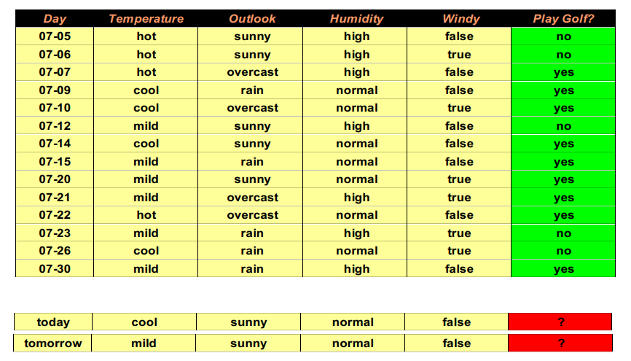
Example

Slide 33
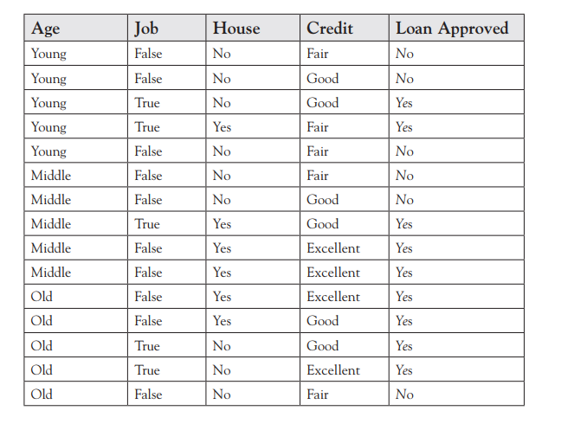
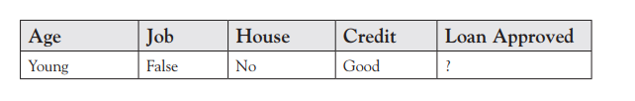
Exs

Slide 34
Super attributes
The information gain equation is biased toward attributes that have a large number of values over attributes that have a smaller number of values.
These ‘Super Attributes’ will easily be selected as the root node, resulted in a broad tree that classifies perfectly but performs poorly on unseen instances.
We can penalize attributes with large numbers of values by using an alternative method for attribute selection, referred to as Gain Ratio.

Slide 35
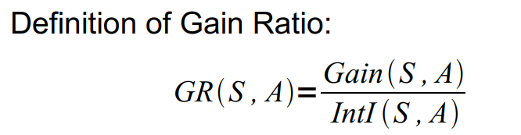
Gain Ratios for weather data
- modification of the information gain that reduces its bias towards multi-valued attributes - takes number and size of branches into account when choosing an attribute -- corrects the information gain by taking the intrinsic information of a split into account This may cause several problems: Overfitting ● selection of an attribute that is non-optimal for prediction Fragmentation ● data are fragmented into (too) many small sets

Slide 36
Split on Day

Slide 37
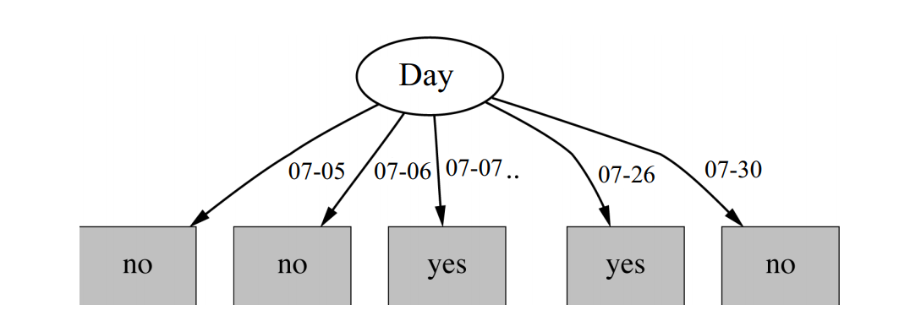
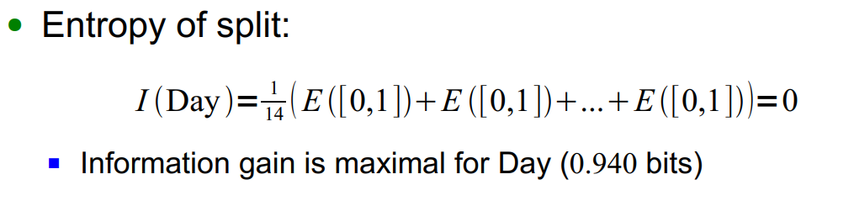
Split on Day(ID)

Slide 38
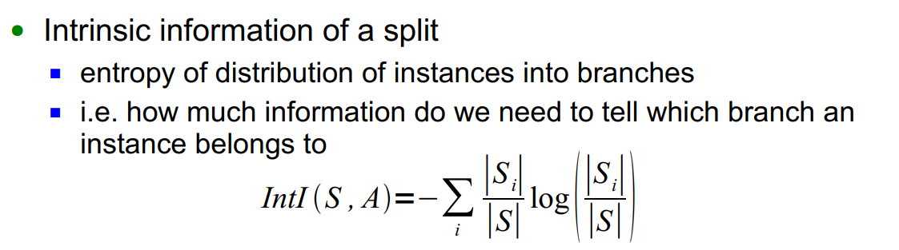
Intrinsic Information of an Attribute

Slide 39
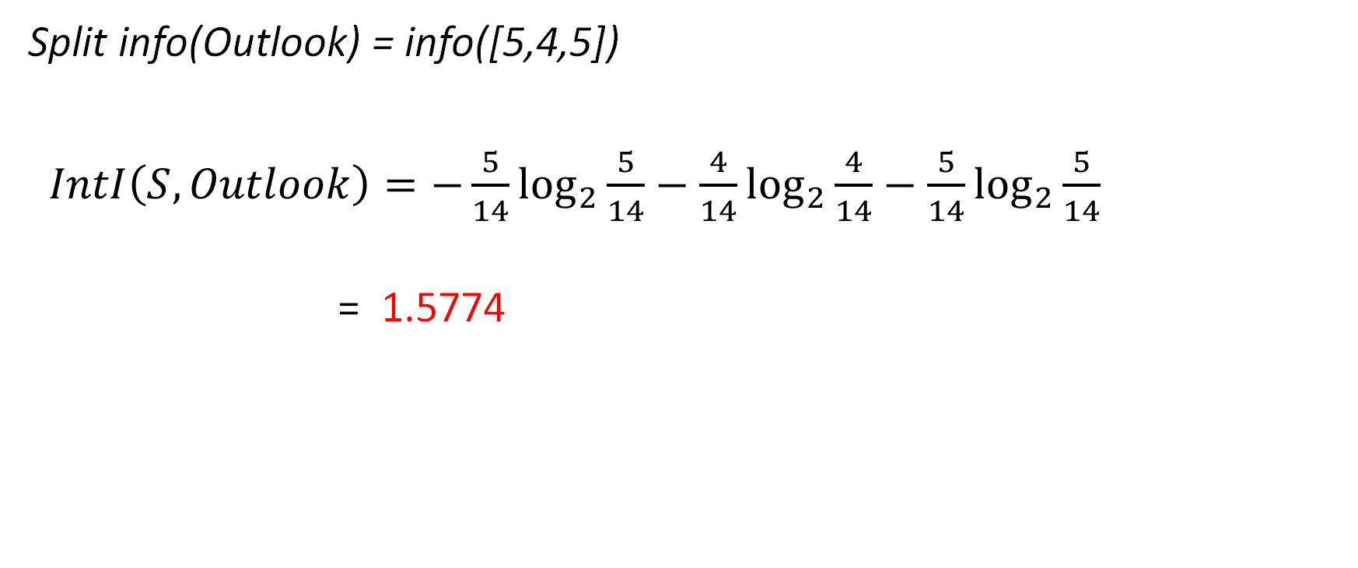
Intrinsic Info: Outlook
Split info(Outlook) = info([5,4,5])
$IntI\left(S, Outlook\right)=−\frac{5}{14}\log_{2}{\frac{5}{14}}−\frac{4}{14}\log_{2}{\frac{4}{14}}−\frac{5}{14}\log_{2}{\frac{5}{14}}$
= 1.5774

Slide 40
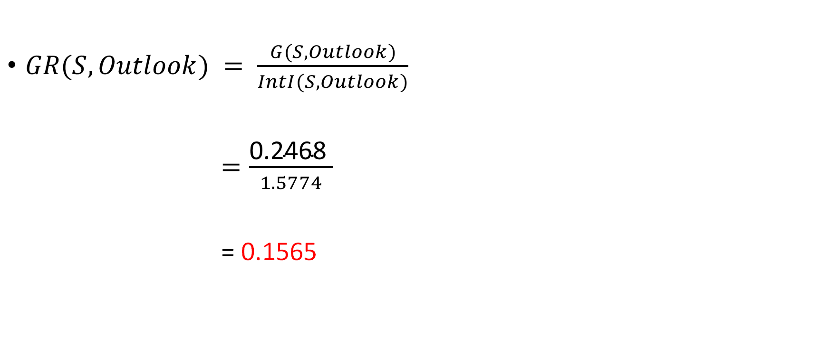
Gain Ratio
$GR(S, Outlook) = \frac{G(S, Outlook)}{IntI(S,Outlook)}$
$=\frac{\text{0.2468} }{1.5774}$
= 0.1565

Slide 41
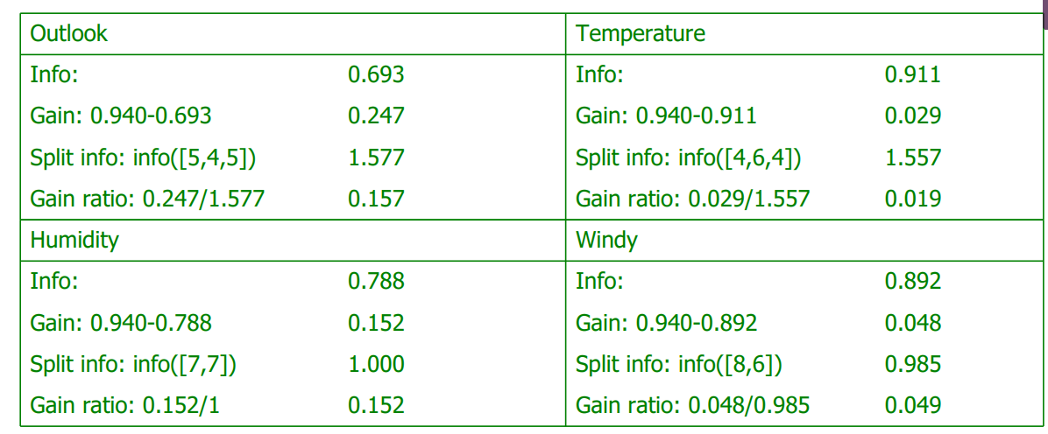
Summary.

